Slide 1
Parallel Computing Class Homework Assignment Proposal
Mike Roberts

Slide 2
Goals
Reasonable coverage of important parallel primitives and interesting image processing applications
Emphasis on empirical performance evaluation

Slide 3
Parallel primitives covered in this proposal
Map
Scatter/Gather
Stencil
Reduce
Scan
Segmented Scan
Compact
Sort

Slide 4
Image processing applications covered in this proposal
Color Conversion
Gaussian Blur
Bilateral Filtering
Red Eye Removal
Tonemapping
Poisson Blending
Graph Cuts

Slide 5
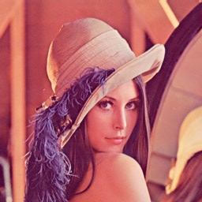
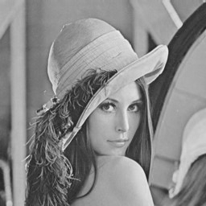
HW1: Greyscale Conversion

Slide 6
HW1: Greyscale Conversion
Hello CUDA
Convert color image to greyscale
Parallel primitives covered:
Map
Performance evaluation questions:
How does performance vary with block size?
How does performance vary with image size?
Estimated difficulty: Easy

Slide 7
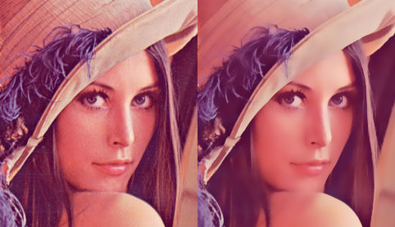
HW2: Gaussian Blur and Smart Blur using the Bilateral Filter

Slide 8
HW2: Gaussian Blur and Smart Blur using the Bilateral Filter
Typical Guassian Blur using convolution
Bilateral filter is just like Gaussian blur but with data-dependent kernel weights.
See Joe Stam’s GTC 2009 talk, “Convolution Soup: A Case Study in CUDA Optimization” for possible optimizations
Parallel primitives covered:
Map, Scatter/Gather, Stencil
Performance evaluation questions:
What memory space to put blur kernel?
How does performance vary with kernel size?
Can we put the image to be blurred in texture memory?
How does performance vary with image size?
Estimated difficulty: Moderate

Slide 9
HW2: Gaussian Blur and Smart Blur using the Bilateral Filter
Decided against anisotropic diffusion for implementing smart blur
Although anisotropic diffusion can produce comparable results to bilateral filtering, it is less common in the literature
Anisotropic diffusion also has more parameters to tune and requires iteratively solving a partial differential equation over the image domain
In contrast, bilateral filtering has fewer parameters to tune and requires only one pass over the image.
Therefore, I think it is more useful to expose students to bilateral filtering

Slide 10

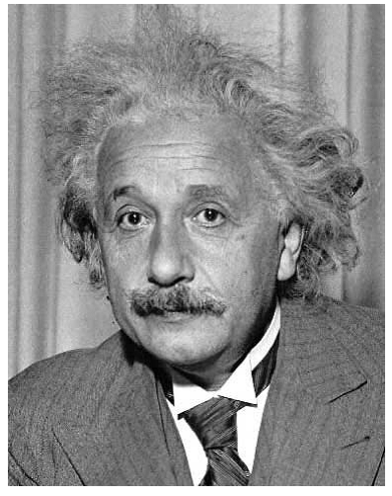
HW3: Automatic Red Eye Removal Using Template Matching (optional – we might want to replace this one)

Slide 11
HW3: Automatic Red Eye Removal Using Template Matching (optional – we might want to replace this one)
Convolve original image with an eye template to produce a response image
Eye pixels will be the brightest pixels in the response image
Sort pixels in the response image according to brightness to get all the eye pixels in the original image
Reduce the redness of eye pixels
See http://www.cs.illinois.edu/class/sp11/cs543/ (Lecture 7) for details
Use experience from previous assignment, convolution should be easy, students can focus on sorting
Best image processing application I could think of that relies directly on sorting
Parallel primitives covered:
Map, Scatter/Gather, Stencil, Sort
Performance evaluation questions:
Similar to previous assignment, but also how can we implement sort efficiently?
Lots of options for implementing an efficient sort
Estimated difficulty: Moderate

Slide 12
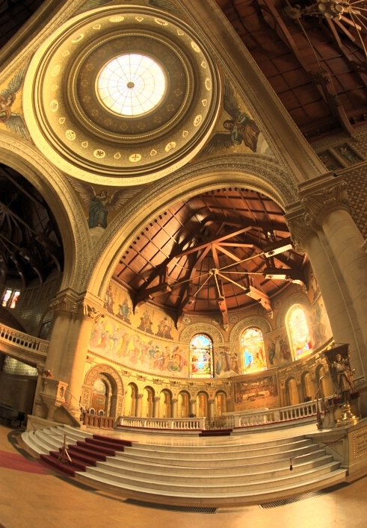
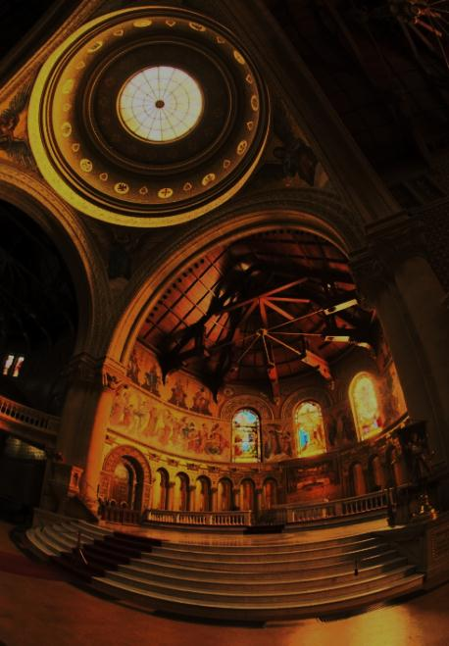
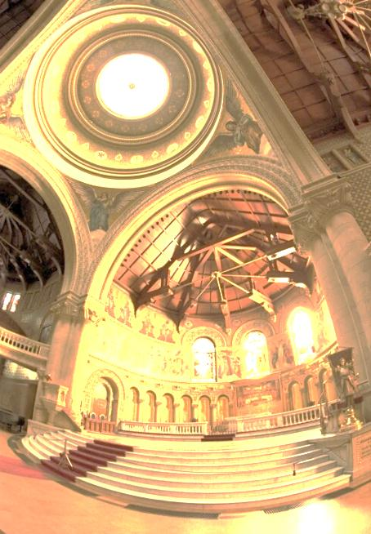
HW4: High Dynamic Range Tone Mapping using Ward’s Histogram Adjustment Operator

Slide 13
HW4: High Dynamic Range Tone Mapping using Ward’s Histogram Adjustment Operator
Compute global minimum and maximum luminance for image (reduce)
Compute luminance histogram for image (scatter/gather using atomic operations)
Adjust histogram using Ward’s algorithm (iterated map and reduce)
Compute the cumulative distribution function for the histogram by prefix-summing the histogram (scan)
Use the cumulative distribution function as the luminance remapping curve (map)
Parallel primitives covered:
Map, Scatter/Gather, Reduce, Scan
See original paper and followup GPU paper for details:
http://radsite.lbl.gov/radiance/papers/lbnl39882/tonemap.pdf
http://developer.amd.com/gpu_assets/GPUHistogramGeneration_I3D07.pdf
Similar homework assignment in MIT Computational Photography course
Decided against Reinhart-style histogram equalization (SIGGRAPH 2002) because it seemed more complicated and less amenable to parallelization
Estimated Difficulty: Moderate

Slide 14
HW5: Implementing Different Histogram Algorithms and Evaluating Their Performance
Implement improved histogram algorithms for the previous assignment and evaluate the relative performance of each:
Sort the input, bin the sorted input, perform segmented prefix sum to accumulate the number of values in each bin, compact to compute histogram
Use shared memory where possible, use a hierarchical decomposition strategy where number of bins exceeds size of shared memory
See the following papers for details:
http://developer.amd.com/gpu_assets/GPUHistogramGeneration_I3D07.pdf
http://developer.download.nvidia.com/compute/cuda/1.1-Beta/x86_website/projects/histogram64/doc/histogram.pdf
http://parse.ele.tue.nl/system/attachments/10/original/GPGPU_High%20Performance%20Predictable%20Histogramming%20on%20GPUs.pdf
http://innovativeparallel.org/Presentations/INPAR%20Modestly%20Faster%20GPU%20Histograms%20PDF.PDF
Parallel primitives covered:
Map, Scatter/Gather, Segmented Scan, Compact, Sort
If students are required to implement sorting in this assignment, then we might want to replace HW3 with HW8
Quite open-ended. We could make this into a contest to see who can get the best performance.
Estimated Difficulty: Hard

Slide 15
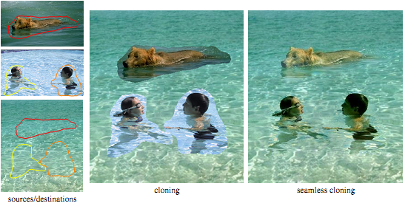
HW6: Seamless Image Compositing using Poisson Blending

Slide 16
HW6: Seamless Image Compositing using Poisson Blending
Given a source image and a target image, compute an output image
The output image must respect a system of linear equations that relates the gradients of the source image, the intensities of the target image, and the intensities of the output image
Construct a system of linear equations and solve using the Jacobi Method
See the following papers for details on Poisson Blending:
http://www.cs.brown.edu/courses/csci1950-g/asgn/proj2/resources/PoissonImageEditing.pdf
http://www.cs.jhu.edu/~misha/Fall07/Notes/Perez.pdf
http://www.cs.jhu.edu/~misha/ReadingSeminar/Papers/Jeschke09b.pdf
See the following paper for details on solving the Poisson equation using the Jacobi Method:
http://http.developer.nvidia.com/GPUGems/gpugems_ch38.html
Parallel primitives covered:
Map, Scatter/Gather, Stencil, Reduce
Performance evaluation questions:
Can we use shared memory to solve the Poisson equation more efficiently?
Are there other numerical methods that we can use to solve the Poisson equation more efficiently?
What are the convergence properties of these methods?
Similar homework assignment in Brown, UIUC, and MIT Computational Photography courses, CMU Advanced Parallel Graphics course
Estimated difficulty: Hard

Slide 17
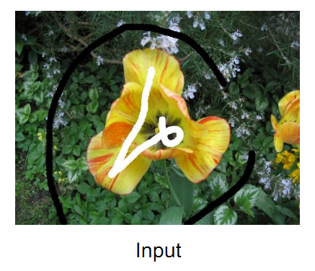
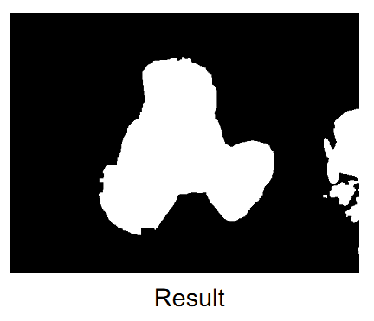
HW7: Selecting Irregular Image Regions using Graph Cuts

Slide 18
HW7: Selecting Irregular Image Regions using Graph Cuts
Set up a weighted undirected graph of nodes (pixels) and edges (connecting neighboring pixels)
Set edge weights according to gradient magnitudes in the image
Execute the push-relabel algorithm on each node in parallel until all nodes converged
Naïve implementation requires global atomic operations
See Timo Stich’s GTC 2009 talk, “Graph Cuts with CUDA” for more details
Parallel primitives covered:
Map, Scatter/Gather, Stencil, Reduce
Similar homework assignment in UIUC Computer Vision course, Brown and MIT Computational Photography courses, CMU Advanced Parallel Graphics course
Estimated difficulty: Hard

Slide 19
HW8: Improving the Performance of Push-Relabel (optional – we need to remove HW3 and replace it with this)
Use shared memory, change degree of parallelism to avoid global atomic operations
Keep list of active image tiles using stream compaction
See the following papers for details:
http://cvit.iiit.ac.in/papers/rtGCuts_2008.pdf
http://people.seas.harvard.edu/~mroberts/data/a_work-efficient_gpu_algorithm_for_level_set_segmentation_hpg_paper.pdf
Parallel primitives covered:
Map, Scatter/Gather, Stencil, Reduce, Scan, Compact
Quite open-ended. We could make this into a contest to see who can get the best performance
Estimated difficulty: Hard

Slide 20
Summary
Topics | HW1: Conversion from Color to Greyscale | HW2: Gaussian Blur and Smart Blur using the Bilateral Filter | HW3: Automatic Red Eye Removal using Template Matching | HW4: High Dynamic Range Tonemapping using Ward's Histogram Adjustment Algorithm | HW5: Implementing Different Histogram Algorithms and Evaluating their Performance | HW6: Seamless Image Compositing using Poisson Blending | HW7: Selecting Irregular Image Regions using Graph Cuts | HW8: Improving the Performance of Push-Relabel
Primitives
Map | X | X | X | X |  | X | X | X
Scatter/Gather |  | X | X | X | X | X | X | X
Stencil |  | X | X |  |  | X | X | X
Reduce |  |  |  | X |  | X | X | X
Scan |  |  |  | X | X |  |  | X
Segmented Scan |  |  |  |  | X
Compact |  |  |  |  | X |  |  | X
Sort |  |  | X |  | X

Slide 21
Notes
Decided against “swishy picture” effect driven by a Stable Fluids simulation
This kind of effect is certainly important, but I feel that the other homework assignments represent image processing operations of broader interest
The most interesting part of most fluid simulations (from parallel programming perspective) is solving the Poisson equation to enforce incompressibility, thereby enforcing global constraints on the fluid
We are covering this pattern in the Poisson Blending assignment

Slide 22
Notes
Decided against fisheye warp effect
This kind of warping is certainly important, but I feel that the other homework assignments represent image processing operations of broader interest
Decided against seam carving
In some sense, the graph cuts assignment is a generalization of seam carving
It seems challenging to expose enough parallelism in the seam carving dynamic programming algorithm
If carving vertically, can only process one row at a time
If carving horizontally, can only process one column at a time
Only 1024 threads of independent work to do for a 1024 X 1024 image

